Slide 1
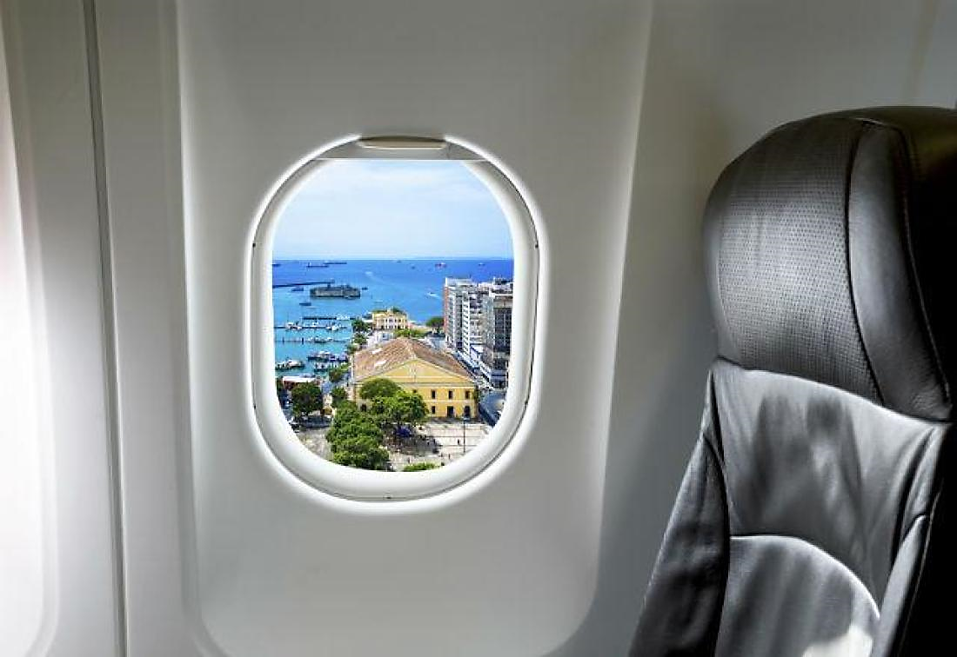

Airline Satisfaction
Cherry Agarwal | Avani Sharma | Rachel Hu
Apoorva Reddy | Abraham Khan

Slide 2
Problem Statement
No one likes flying
Airlines want to provide a good experience to everyone
People value different things
What services are worth focusing on?

Slide 3




Available Data
2015 Customer satisfaction survey – 30k responses w/ 15 attributes
Target variable is recommendation (Yes/No)
Flight info (seating, country, date-time)
Service ratings 1-5 (seats, food, staff)
Additional Comments

Slide 4
EDA
Over 2,400 reviews
Airline name
Date-time of review
Overall rating
Food, Seats, Value, etc.
Additional comments
1,600 reviews from the US
1,800 reviews from economy seats

Slide 5
Approach
Exploratory data analysis – Attribute importance
Visualizations in Tableau accessing a SQL database
Predicting customer satisfaction overall and in segments
Summarization and filtering using MapReduce
Compare computational efficiency on a cloud vs local machine
Notes:
Cherry, Apoorva and Avani, Rachel
MapReduce to filter. Some variables are categorical but others will change with new data

Slide 6
Expected Outcomes
Help airlines identify opportunities and risk factors to confidently make game-changing decisions
Enhancing marketing effectiveness
Increasing loyalty
Improving operational performance
Driving competitive differentiation

Slide 7
US Airline Reviews
United and American have high variability in ratings
Delta and Allegiant have a large majority of positive ratings
Delta is the only one with >50% positive sentiment in reviews
Food and entertainment have high variability between airlines
First class does not have significantly different ratings distributions
Low ratings still make up ~80% of reviews
No airline is rated as high value, not even Frontier

Slide 8
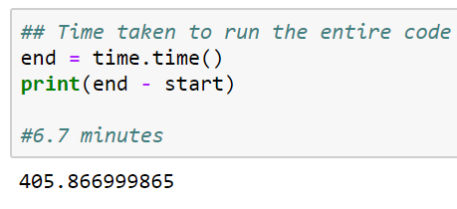
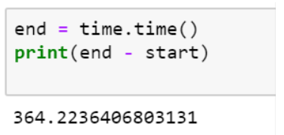
Time on Local & Microsoft Azure
Parameters | Local System Time | Cloud Time
RF with fewer parameters | 6.7 mins | 6.06 mins
RF with more parameters | 70 mins | 40 mins

Slide 9

Questions

